Slide 1
An Open-Source Approach to Prepare Scanned Images for OCR

Slide 2
Hello!
(--,--)
I study math, cs & work as sysadmin.
You can find me at <>

Slide 3
Concept
Use an external OCR solution to resolve images with text
Heal broken images beforehand in order to obtain better results
Not worrying about costs or computation
Not struggling with complicated technical details
Understand common approaches for repairing images

Slide 4
Cloud solutions
1
Use everything they offer to increase productivity
Alerts
Storage & Docs
Databases
Services

Slide 5
2
External OCR
Tessaract OCR engine that is already trained by millions of users
Always try to adapt current solutions , there is no nee d to reinvent the wheel
Their software gets better day by day

Slide 6
Means of improving
3
What can we improve to make text in images recognisable?
Contrast enhancement
Text bleed-through
De-noising
De-warping

Slide 7
Contrast enhancement
Technical specifications:
Year: | Sep 24, 2018
Programming Language: | Python
License: | Open
Author: | Andy Huang
Requires:
numpy | scipy
matplotlib | scikit-image
imageio | git
cv2 | skimage

Slide 8
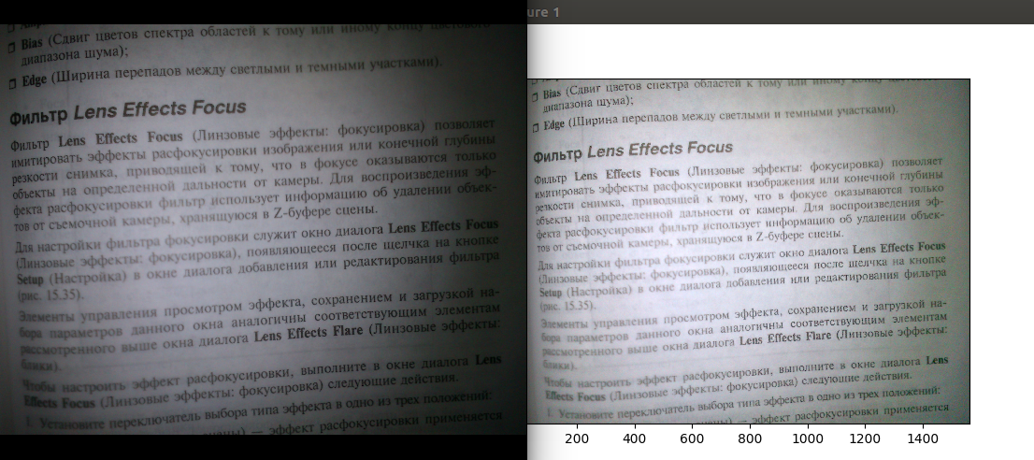
Contrast enhancement

Slide 9
Text bleed-through
Technical specifications:
Year: | Nov 21, 2017
Programming Language: | Matlab
License: | Open
Author: | Jiarui Gao
Requires:
git | matlab

Slide 10
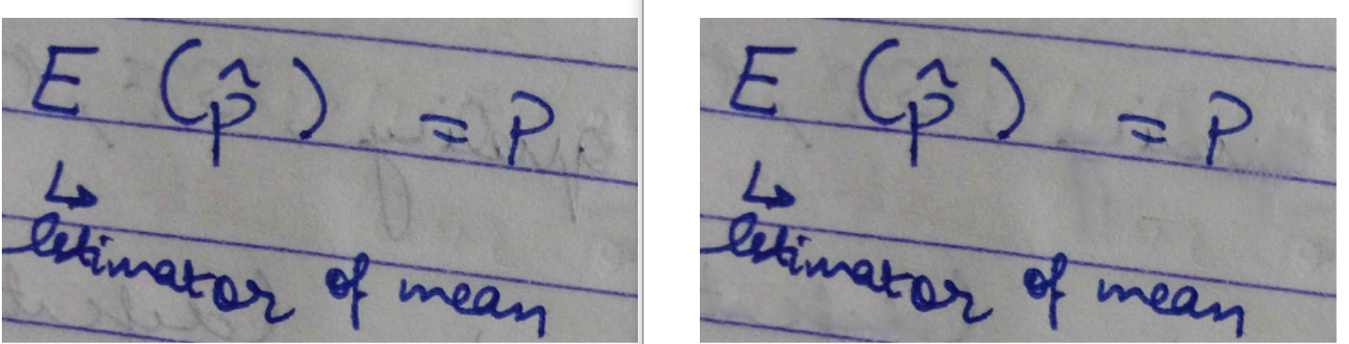
Text bleed-through

Slide 11
De-noising
Technical specifications:
Year: | December 15, 2018
Programming Language: | Bash
License: | For personal use only
Author: | Fred Weinhaus
Requires:
bash | git

Slide 12
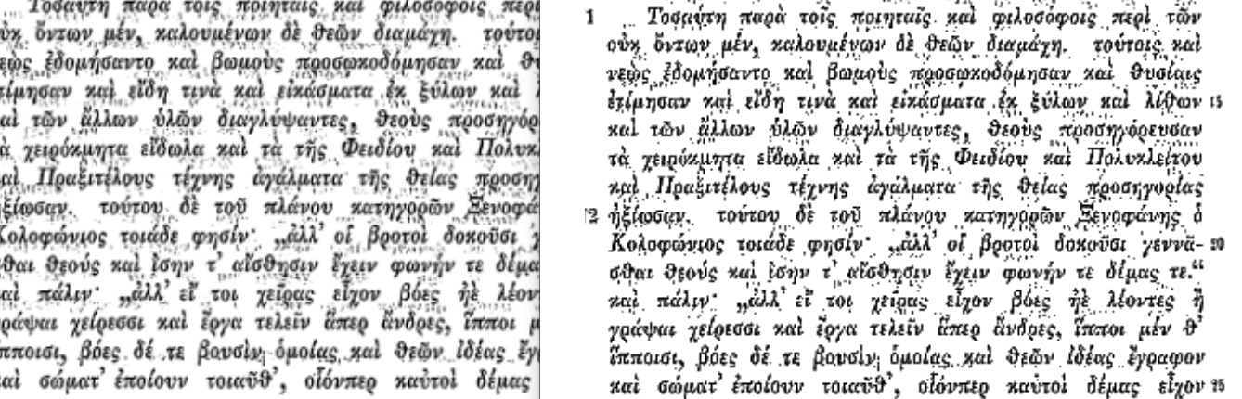
De-noising

Slide 13
De-warping
Technical specifications:
Year: | Oct 2, 2016
Programming Language: | Python
License: | MIT
Author: | Matt Zucker
Requires:
scipy | opencv3
pillow | git

Slide 14
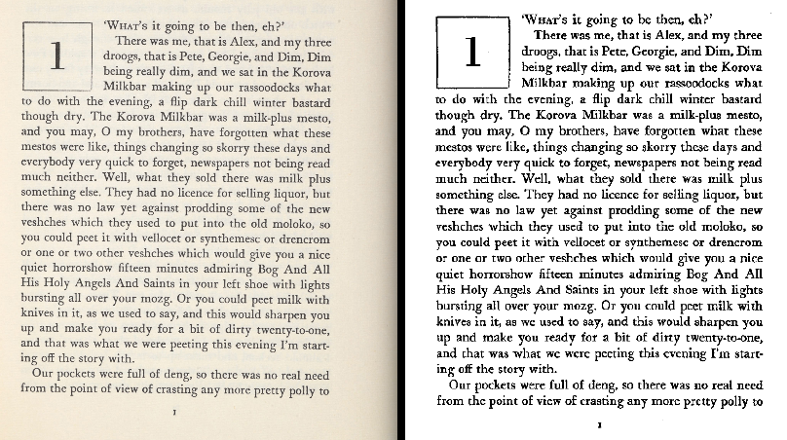
De-warping

Slide 15
Conclusion
4
Easy to implement. Can be used by anyone.
Good for specific scenarios. The parameters of the algorithms can be modified acording to case.
No need for training or hard computations

Slide 16
Thanks!
Any questions?

